Slide 1


BAN210 PREDICTIVE analytics
FINAL PROJECT PRESENTATION
Lesly Pearl Cortez

Slide 2

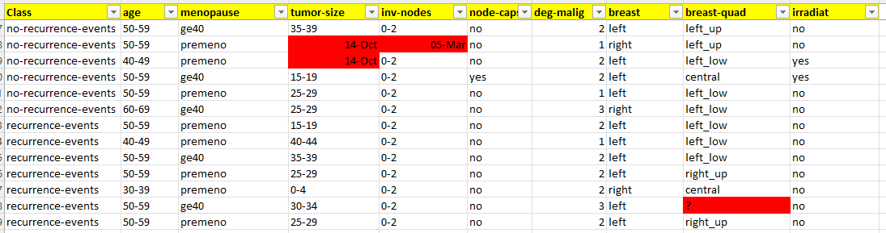
FILE
BREAST CANCER DATASET https://archive.ics.uci.edu/ml/datasets/Breast+Cancer
The instances are described by 9 attributes, some of which are numeric, and some are nominal.
Notes:
- We will put our data set to EDA, to understand and get familiar with the structure of data and identify initial driver of risk
A quick look on the data, we can see values that are not as expected as seen on the highlight cells.
Obvious indication that we need to do data clean up.

Slide 3
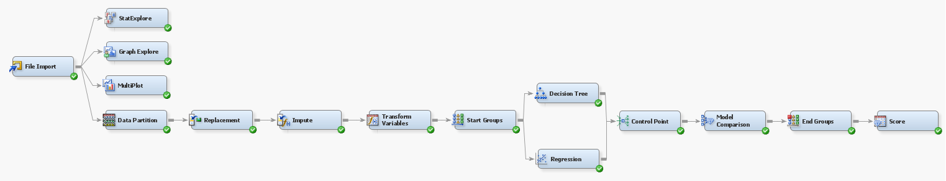
DIAGRAM

Slide 4
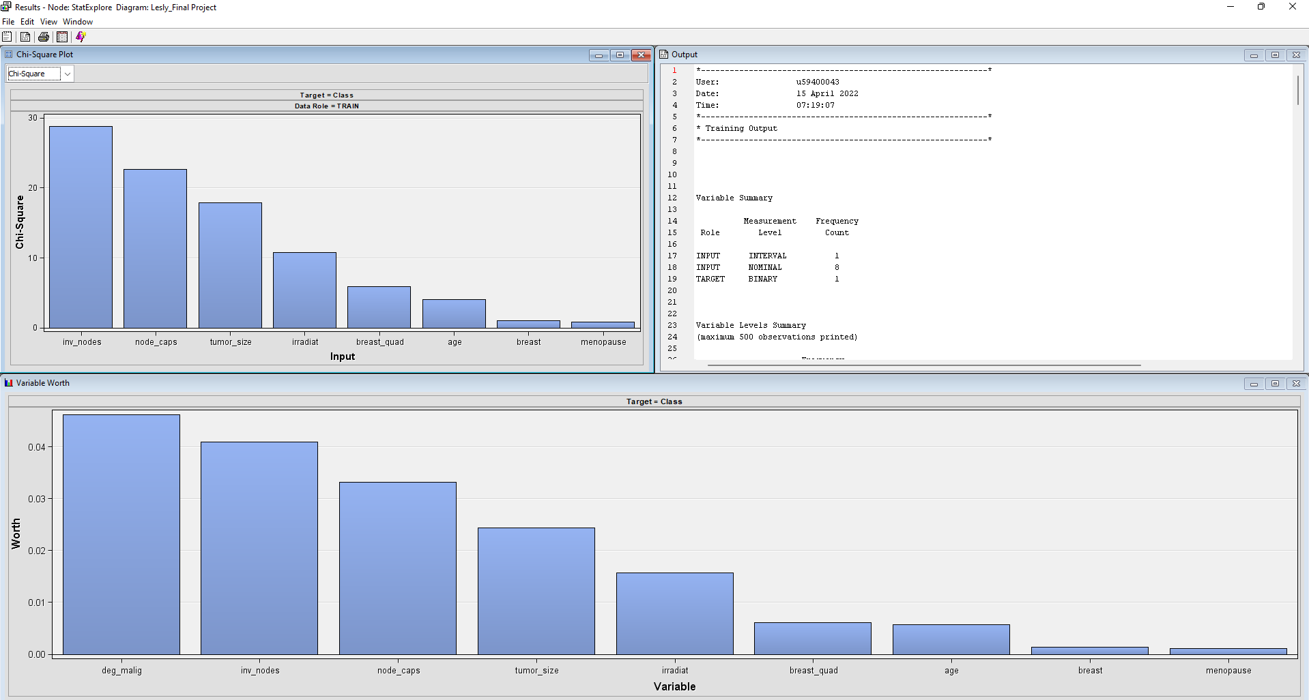
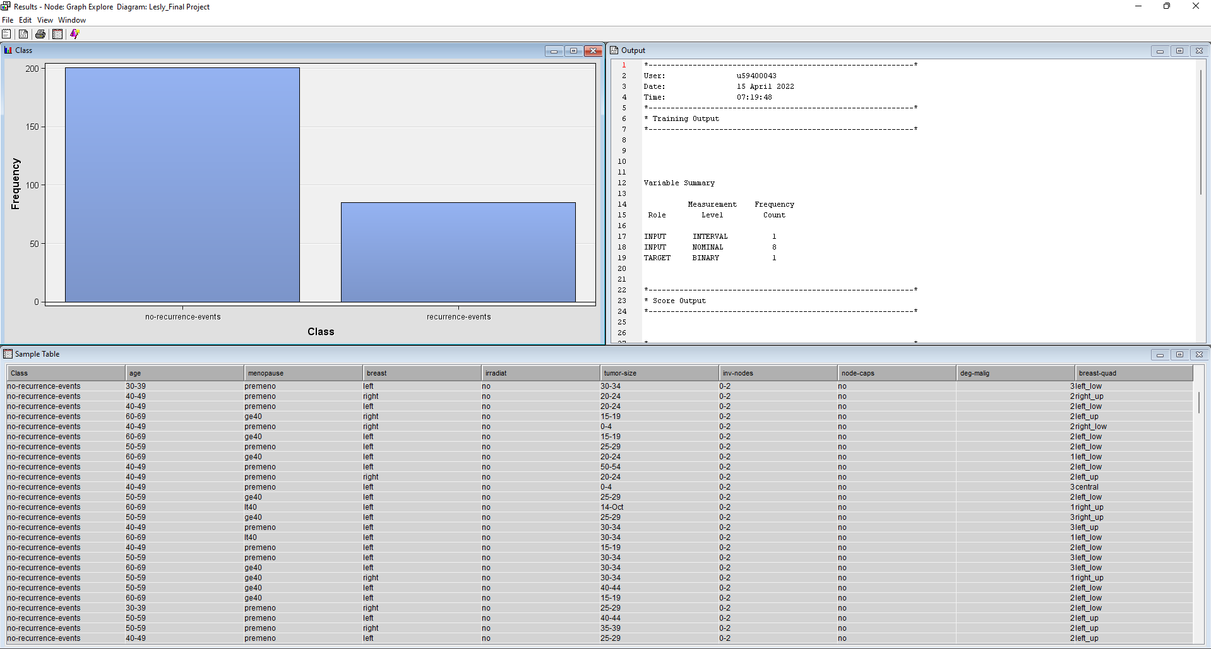
EXPLORATORY DATA ANALYSIS (EDA)
STAT EXPLORE
GRAPH EXPLORE
Notes:
I use Stat-Explore node to generate the summary statistics and examine variable distribution and statistics.
I also use Graph Explore node to explore the data graphically to uncover patterns and trends.
CLASS is set as target variable
201 No-recurrence-events
85 recurrence-events

Slide 5
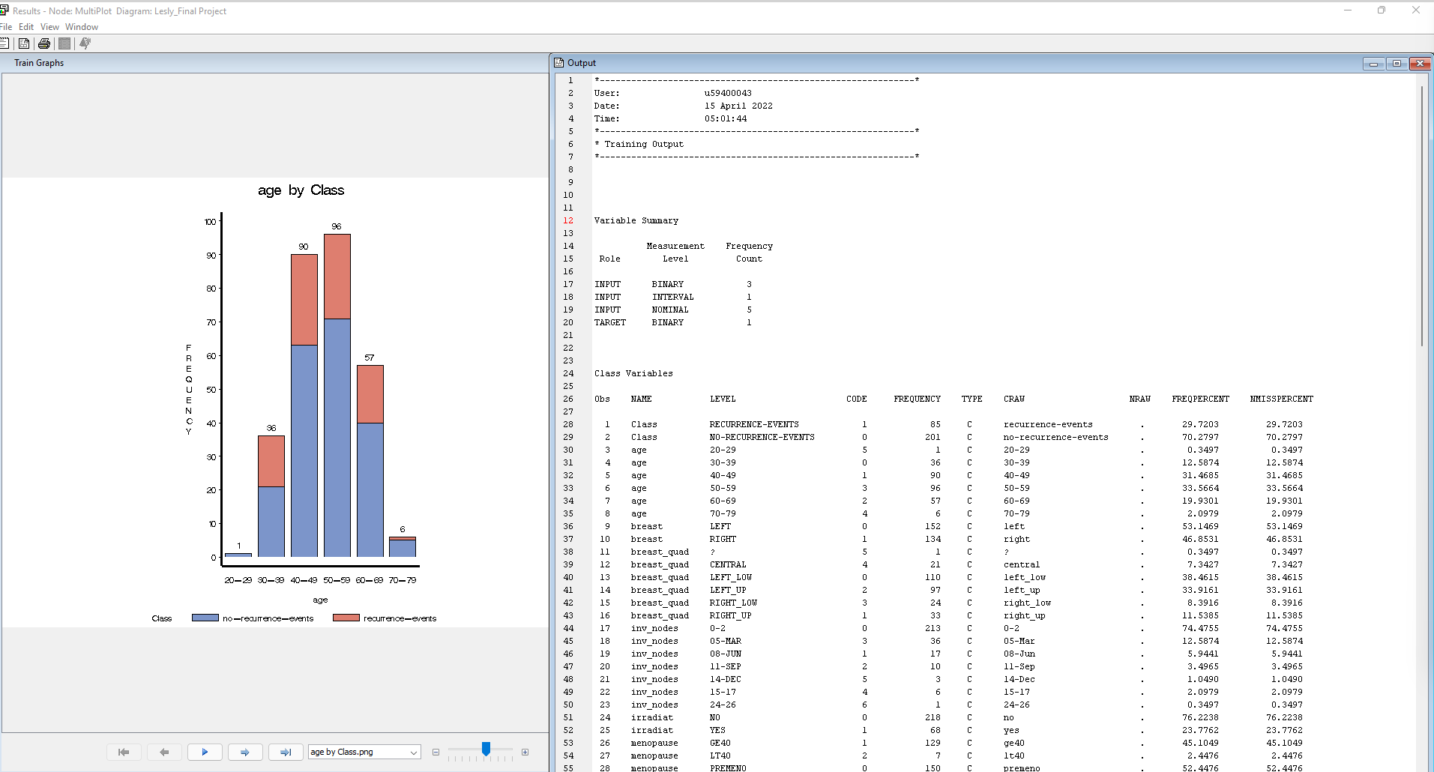
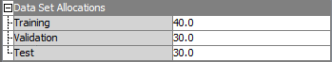
EXPLORATORY DATA ANALYSIS (EDA)
MULTIPLOT
DATA PARTITION
Notes:
I use MultiPlot node to explore the data graphically to observe data distributions and to examine relationships among the variables.
As you can see on the node output, it gives a variable summary like for Input as Role, there are 3 binary, 1 interval, 5 nominal. While we only set 1 target variable which is a binary.
Also there is a more specific level of frequency report based on how many time the value appear on specific variables.
The data was split as 40% training, 30% validation, and 30% test.

Slide 6
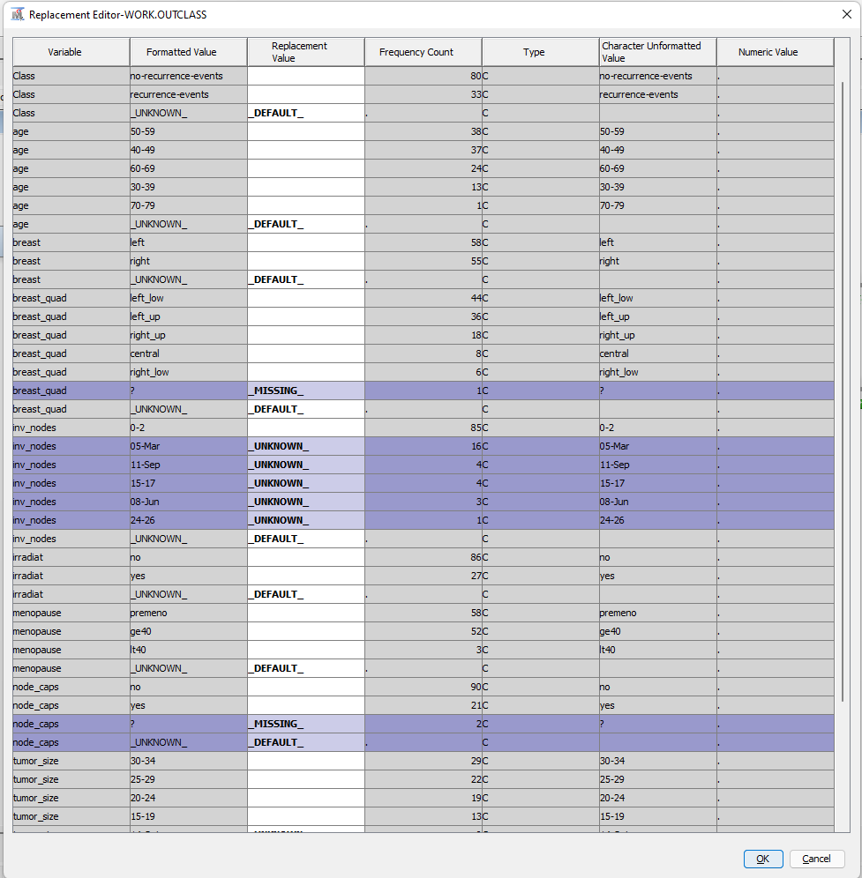
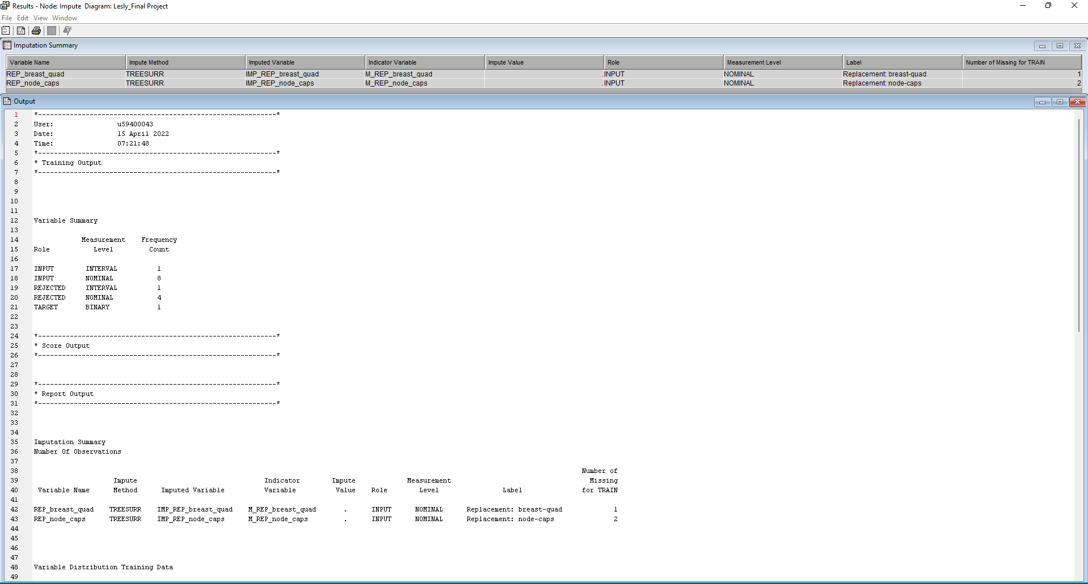
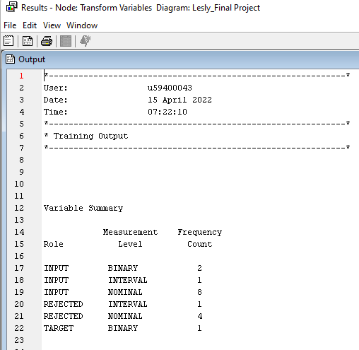
DATA PREPARATION AND CLEANUP
REPLACEMENT
IMPUTE
TRANSFORM
Notes:
We use Replacement node to generate score code to process unknown levels when scoring and also to interactively specify replacement values for class and interval levels.
Using Replacement Editor in the Replacement Node property, we
Enter _MISSING_ as the Replacement Value for observations with the value ?
Enter _UKNOWN_ as the Replacement Value for observation with the value in Date format.
The we also use the Impute node to replace missing values in data sets using Tree Surrogate input method for both Class and Interval variables
This imputation resulted to 2 variables: REP_breast_quad and REP_node_caps
The we did a transformation for the interval variable REP_deg_malig by setting the method to Max. Normal.
In the variable summary, you can see that there is a difference between the number of role and frequency count before (from imputation) and after transformation

Slide 7
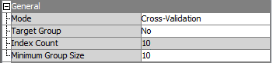
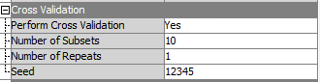
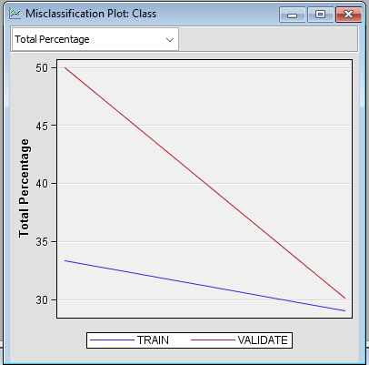
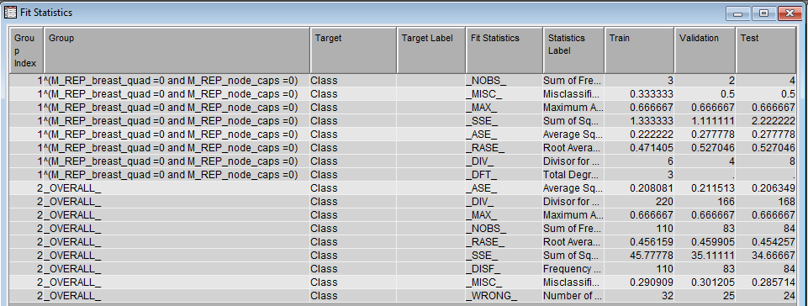
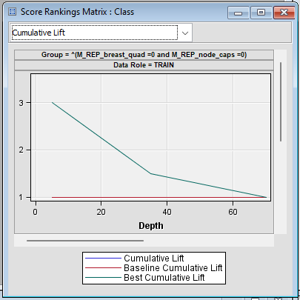
DECISION TREE MODEL
Start Groups
Decision Tree

Slide 8
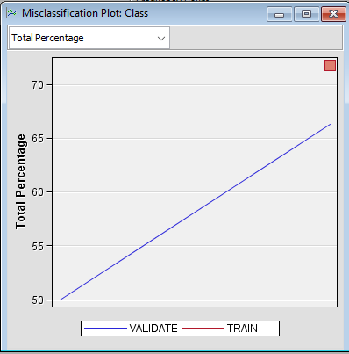
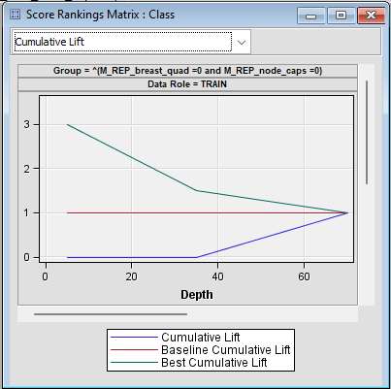
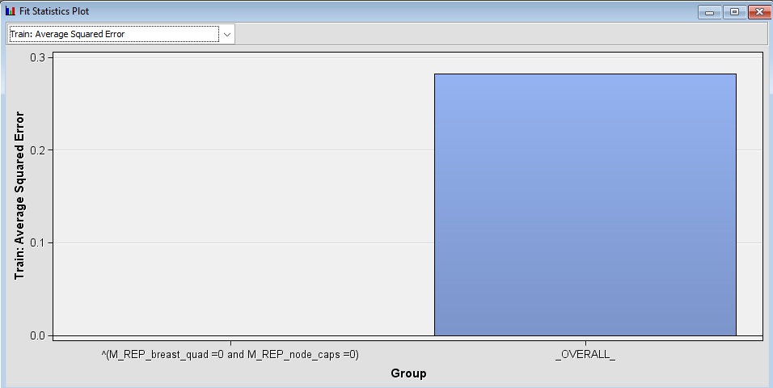
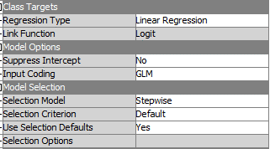
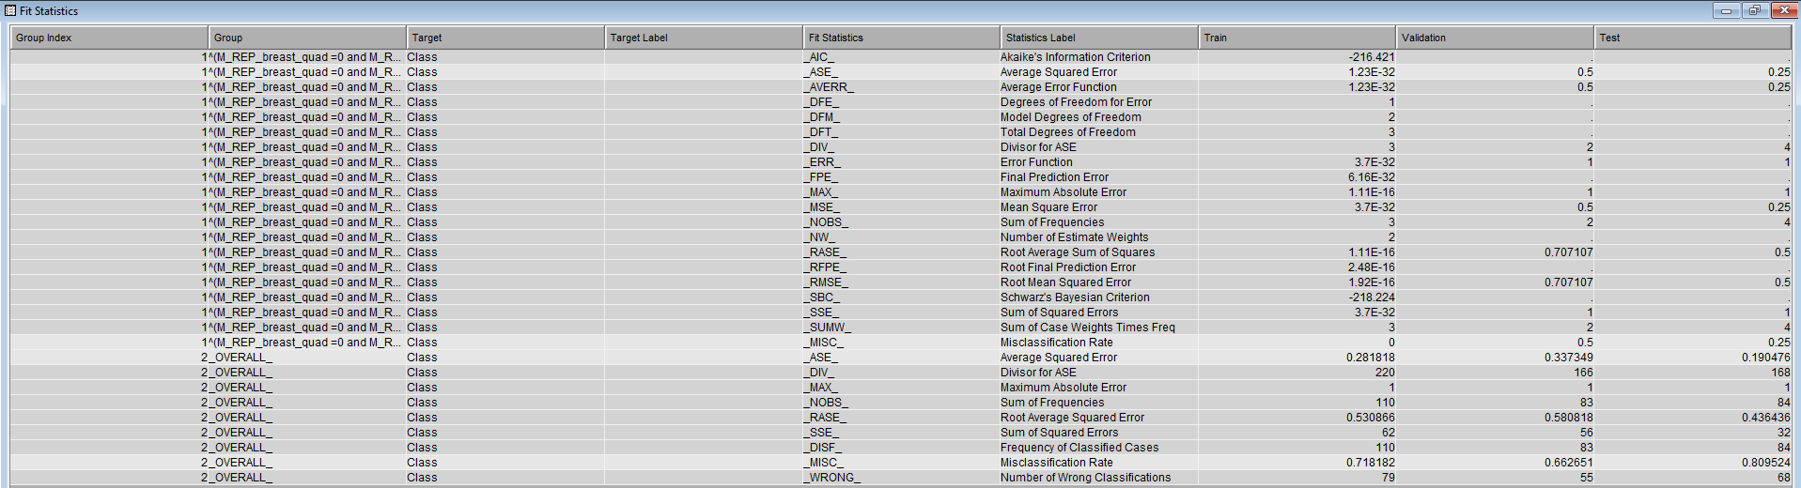
REGRESSION MODEL
Start Groups
Regression

Slide 9
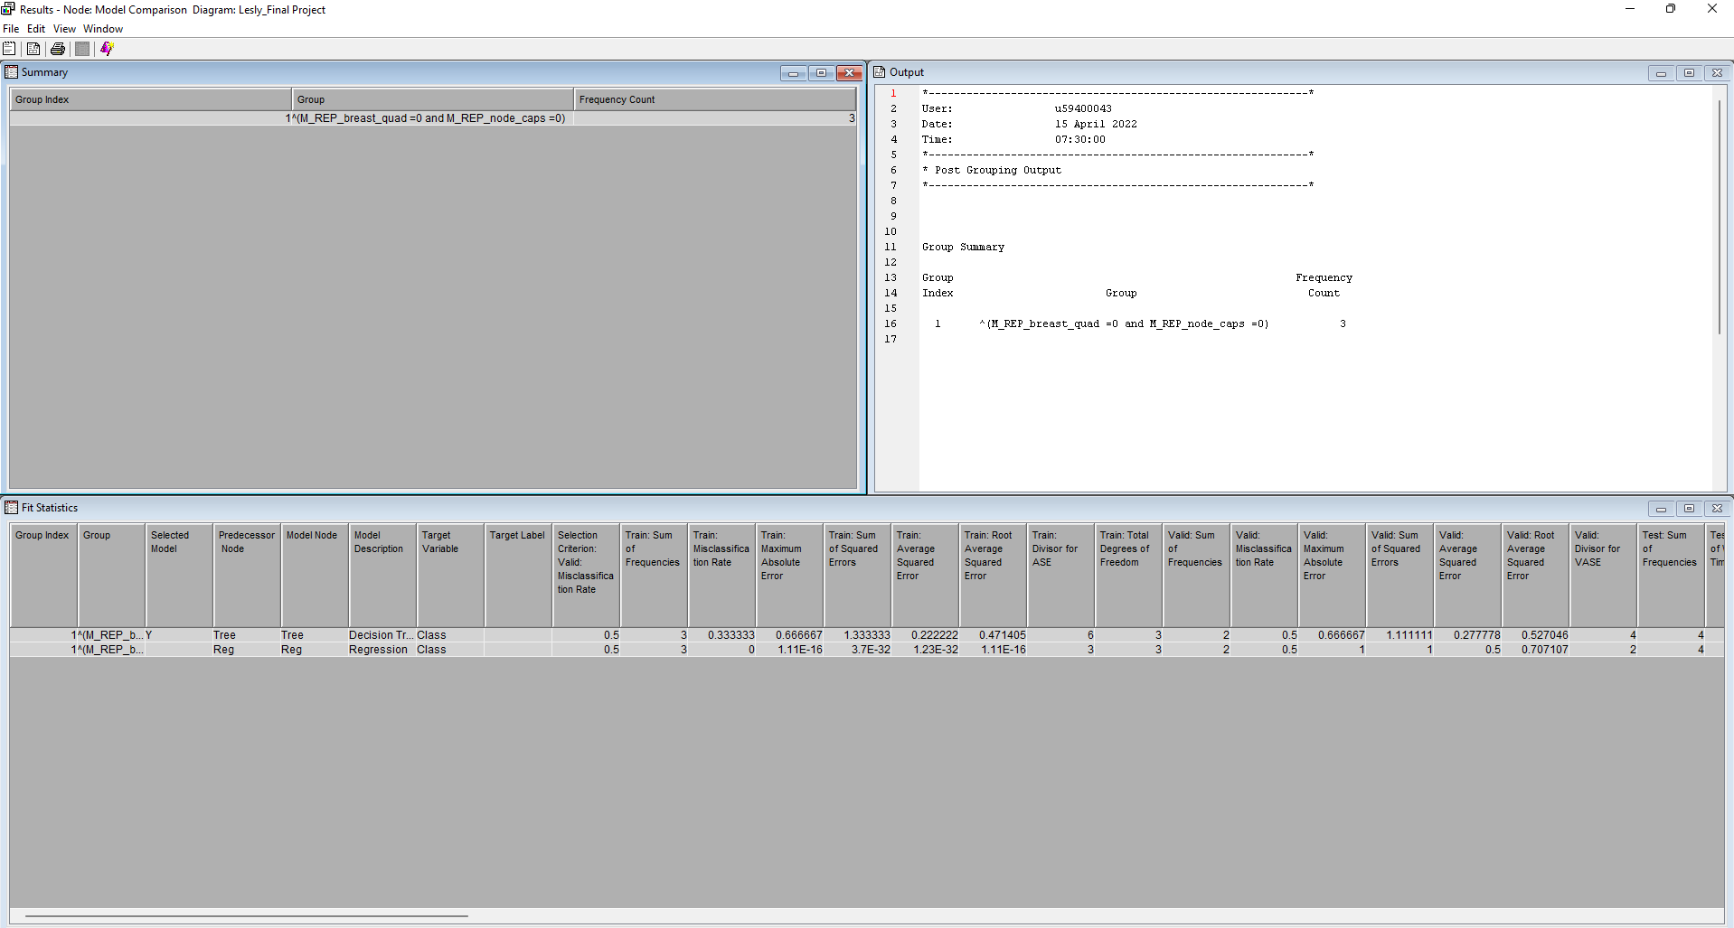
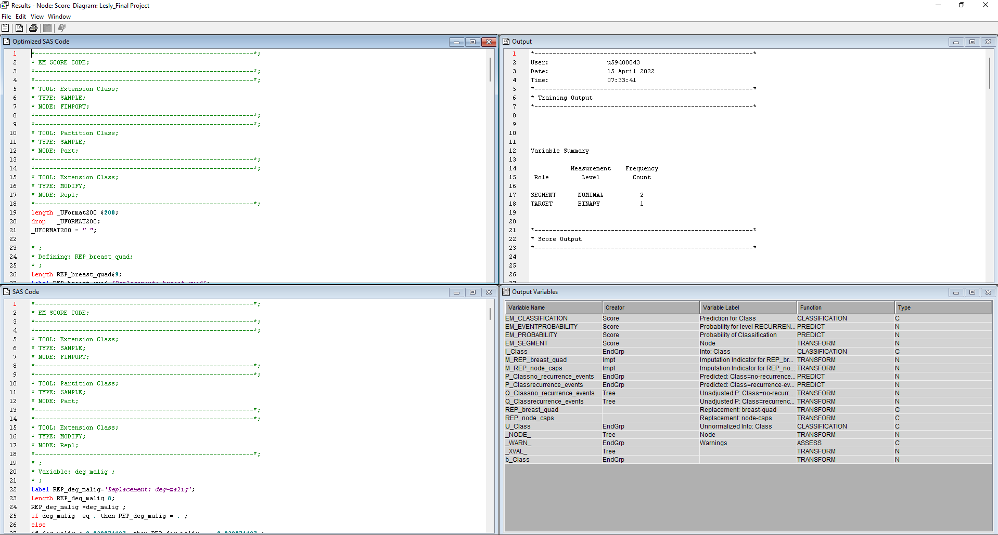
MODEL COMPARISON and SCORE
Notes:
ASE:
Train - Tree
Valid - Tree
Test – Reg
MISC
Train - Reg
Valid – Same/Equal
Test – Reg
CONCLUSION: REGRESSION

